Slide 1

WPDD202: Webpage Design & Development
Version 2 – 18th December 2015

Slide 2
Client server internet models and applications
Chapter E4

Slide 3
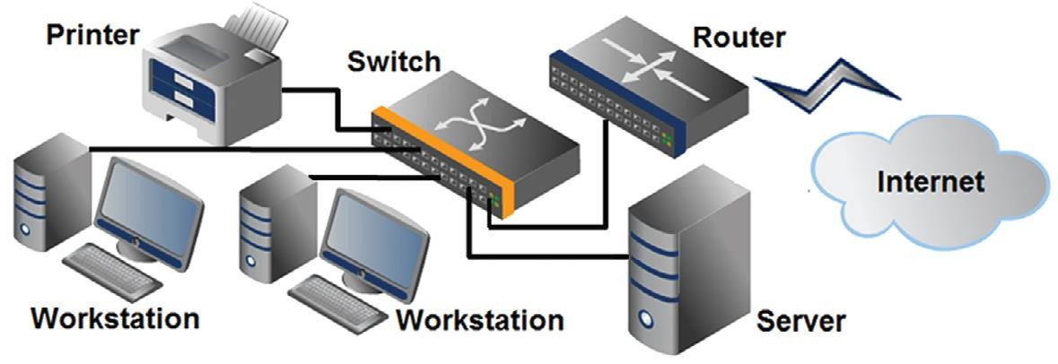
Network Overview
Network
two or more computers connected together for the
purpose of communicating and sharing resources

Slide 4
The Client/Server Model
Client/Server can describe a relationship between two computer programs – the "client" and the "server".
Client
requests some type of service (such as a file or
database access) from the server.
Server
fulfills the request and transmits the results to the client
over a network

Slide 5
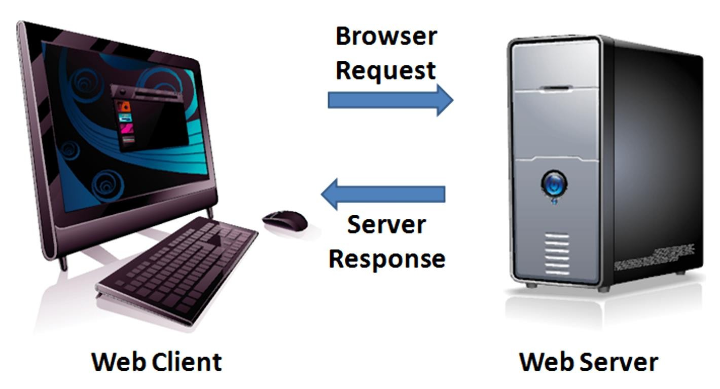
The Client/Server Model
The Internet Client/Server Model
Client: Web Browser
Server: Web Server

Slide 6
Internet Protocols
Protocols
› Rules that describe the methods used for clients and servers to communicate with each other over a network.
There is no single protocol that makes the
Internet and Web work.
A number of protocols with specific
functions are needed.

Slide 7

Common Internet Protocols
Official Communication Protocol: TCP/IP
Specialized Protocols:
File Transfer: FTP
E-mail: SMTP, POP3, IMAP
Websites: HTTP

Slide 8
HTTP Hypertext Transfer Protocol
A set of rules for exchanging files such as text, graphic images, sound, video, and other multimedia files on the Web.
HTTP Request
HTTP Response
Web browsers send HTTP requests for web pages and their associated files.
Web servers send HTTP responses back to the web browsers.

Slide 9
IP Address
Each device connected to the Internet has a
unique numeric IP address.
These addresses consist of a set of four groups of numbers, called octets.
74.125.73.106 will get you Google!
An IP address may correspond to a domain name.

Slide 10
Domain Name
Locates an organization or other entity on the Internet
Domain Name System
Divides the Internet into logical groups and
understandable names
Associates unique computer IP Addresses with the text-based domain names you type into a web browser
Browser: http://google.com
IP Address: 74.125.73.106

Slide 11
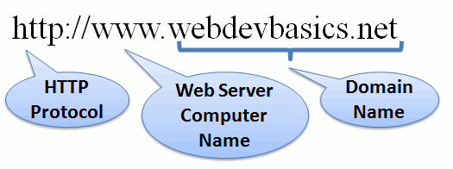
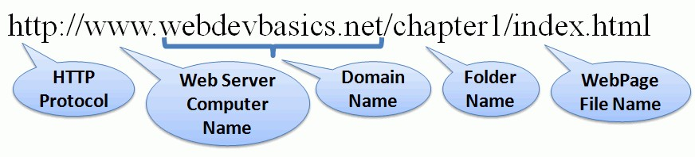
Uniform Resource Indicator
URL
Uniform Resource Locator
Represents the address of a resource
on the Internet.

Slide 12
Top-Level Domain Name
A top-level domain (TLD) identifies the right- most part of the domain name.
Some generic TLDs:
.com, .org, .net, .mil, .gov, .edu, .int, .aero,
.asia, .cat, .jobs, .name, .biz, .museum, .info,
.coop, .pro, .travel

Slide 13
County Code TLDs
Two character codes originally intended to indicate the geographical location (country) of the web site.
In practice, it is fairly easy to obtain a domain name with a country code TLD that is not local to the registrant.
Examples:
.tv, .ws, .au, .jp, .uk
See http://www.iana.org/cctld/cctld-whois.htm

Slide 14






Domain Name System
The Domain Name System (DNS) associates
Domain Names with IP addresses.
Domain Name
IP Address
DNS
Web Browser
Web
Server
requests web page
Use TPC/IP
send HTTP Request
Use TCP/IP
to send HTTP Responses
with web page files & images
Web Browser
displays web page
23
23

Slide 15
Markup Languages
SGML – Standard Generalized Markup
Language
› A standard for specifying a markup language or
tag set
HTML – Hypertext Markup Language
› The set of markup symbols or codes placed in a file intended for display on a web browser.
Element or tag – individual markup code
Attribute – modifies the purpose of a tag

Slide 16
Markup Languages (2)
XML – eXtensible Markup Language
A text-based language designed to describe, deliver,
and exchange structured information.
It is not intended to replace HTML –
it is intended to extend the power of HTML by
separating data from presentation.

Slide 17
Markup Languages (3)
XHTML – eXtensible Hypertext Markup Language
Developed by the W3C as the reformulation of HTML 4.0
as an application of XML.
It combines the formatting strengths of HTML 4.0 and the data structure and extensibility strengths of XML.

Slide 18

Markup Languages (4)
HTML 5
› The next version of HTML 4 and XHTML 1
Currently in draft status
Incorporates features of both HTML and XHTML
Adds new elements
Eliminates some elements
Intended to be backward compatible
› http://www.w3.org/html/

Slide 19

kent.edu.au Kent Institute Australia Pty. Ltd. ABN 49 003 577 302 ● CRICOS Code: 00161E ● RTO Code: 90458 ● TEQSA Provider Number: PRV12051

